Slide 1
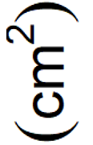
(b)
(c)
(a)
(d)
(e)

Slide 2
no significant interactions
no significant interactions
no significant interactions
no significant interactions

